Slide 1
Software Design for Cloud 2_2
Python Programming
Lecture 6
Inheritance

Slide 2
Software Design for Cloud 2_2
Python Programming
Lecture 6
Inheritance

Slide 3
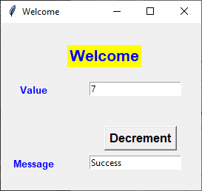
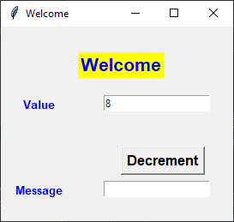



Slide 4
Base Classes
class Counter:
def __init__(self, val):
self.value = val
def setValue(self,val):
self.value=val
def getValue(self):
return self.value
def decrement(self):
if (self.value>0):
self.value -= 1
return True
else:
return False

Slide 5
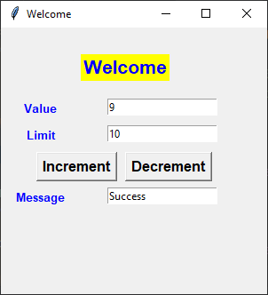
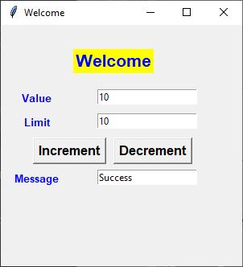
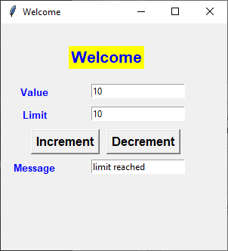
Now we want to extend the class Counter to add:
- limit attribute (upperLimit value can’t go above)
- increment method (steps value up by 1)
- getLimit method (returns the value of the limit)

Slide 6
Derived Classes
class MyCounter (Counter):
def __init__(self, val, lim):
super().__init__(val)
self.limit = lim
def increment(self):
if (self.value < self.limit):
self.value += 1
return True
else:
return False
def getLimit(self):
return self.limit

Slide 7
class MyCounter (Counter): # Extends Counter
def __init__(self, val, lim): # Constructor receives 2 parameters
super().__init__(val) # calls base class Constructor
self.limit = lim
def increment(self): # Extra Function uses ‘value’ from base
if (self.value < self.limit):
self.value += 1
return True
else:
return False
def getLimit(self):
return self.limit

Slide 8
Classes Defining an Object
class MyCounter (Counter):
def __init__(self, val, lim):
super().__init__(val)
self.limit = lim
def increment(self):
if (self.value < self.limit):
self.value += 1
return True
else:
return False
def getLimit(self):
return self.limit
def main():
c1=MyCounter(8,10)
print('Init Value=', c1.getValue())
c1.decrement()
print('New Value=', c1.getValue())
c1.increment()
print('New Value=', c1.getValue())
print(Limit=', c1.getLimit())
main()

Slide 9
Putting Classes in separate File
class MyCounter (Counter):
def __init__(self, val, lim):
super().__init__(val)
self.limit = lim
def increment(self):
if (self.value < self.limit):
self.value += 1
return True
else:
return False
def getLimit(self):
return self.limit
def main():
c1=MyCounter(8,10)
print('Init Value=', c1.getValue())
c1.decrement()
print('New Value=', c1.getValue())
c1.increment()
print('New Value=', c1.getValue())
print(Limit=', c1.getLimit())
main()

Slide 10
3 levels of attribute accessibility
class X:
def __init__(self, val1,val2,val3):
self.value1 = val1 # public, fully available
self.__value2 = val2 # private, only available within X class
self._value3 = val3 # protected, available within X class
# plus any class that inherits X
If value in base class is private
Derived class can’t directly access __value

Slide 11
Protected Variables
class Counter:
def __init__(self, val):
self.__value = val
def setValue(self,val):
self.__value=val
def getValue(self):
return self.__value
def decrement(self):
if (self.__value>0):
self.__value -= 1
return True
else:
return False
If value in base class is private
Derived class can’t directly access __value

Slide 12
Protected Variables
class Counter:
def __init__(self, val):
self.__value = val
def setValue(self,val):
self.__value=val
def getValue(self):
return self.__value
def decrement(self):
if (self.__value>0):
self.__value -= 1
return True
else:
return False
If value in base class is private
class MyCounter (Counter):
:
Error
def increment(self):
if (self.__value < self.limit):
self.__value += 1
return True
else:
return False

Slide 13
Use Protected Variables
If value in base class is private
class MyCounter (Counter):
:
OK
def increment(self):
if (self._value < self.limit):
self._value += 1
return True
else:
return False
class Counter:
def __init__(self, val):
self._value = val

Slide 14
#MyClasses.py
class Counter:
def __init__(self, val):
self.__value = val
def setValue(self,val):
self.__value=val
def getValue(self):
return self.__value
def decrement(self):
if (self.__value>0):
self.__value -= 1
return True
else:
return False
class MyCounter (Counter): :
Ideally put classes in a separate File from Client
#MyClient.py
from tkinter import *
window = Tk()
window.geometry("300x300")
window.title("Welcome")
from MyClasses import *
def display():
value = c1.getValue()
limit = c1.getLimit()

Slide 15
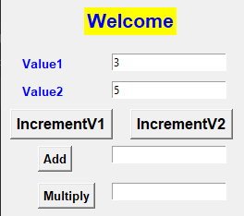

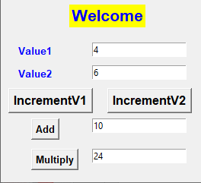

Ex211
Single
-------------------------------------
value1 (int) # protected
--------------------------------------
__init__(int)
incrValue1()
int getValue1()
Pair
-------------------------------------
value2 (int)
--------------------------------------
__init__(int,int)
incrValue2()
int getValue2()
int add()# return value1+value2
int multiply()

Slide 16
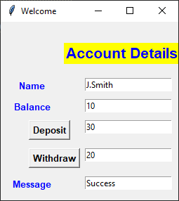
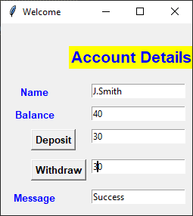
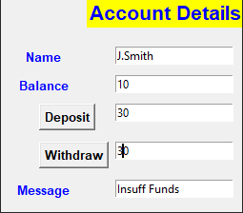

Ex212
Account
-------------------------------------
balance (int) # protected
--------------------------------------
__init__(int)
getBalance() # return int
withdraw(amt) # return bool
DepositAccount
-------------------------------------
name (string) # private
--------------------------------------
__init__(string,int)
getName() # return string
deposit(amt) # add to balance

Slide 17
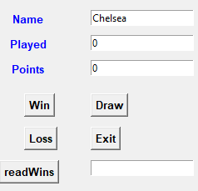
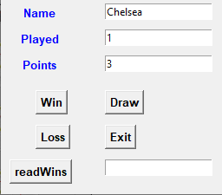
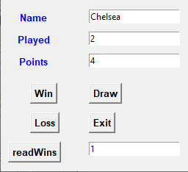

Ex213
Team
name (str)
played (int)
points (int)
--------------------------------------
__init__(str) # played, points 0
draw() # points+1, played+1
loss() # played+1
str getName()
int getPoints()
int getPlayed()
FootballTeam
wins (int) # number of wins
--------------------------------------
__init__(string) wins set to 0
win() # points+3, wins+1, played+1
int getWins()
3 points for a win, 1 for a draw

Slide 18
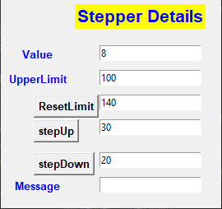
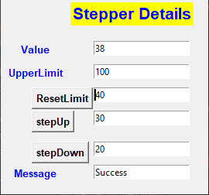
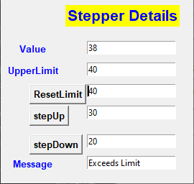
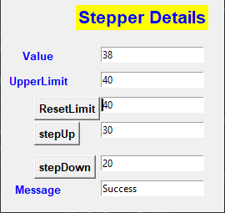
Ex214
Stepper
value (int) #protected
--------------------------------------
__init__(int)
stepDown(int) # return bool
int getValue()
MyStepper
limit (int) # private upper limit
--------------------------------------
__init__(int,int) # value,limit
stepUp(int) # return bool
int getLimit()
resetLimit(int)

